Slide 1


Entrepreneurship Basics
VX 420: Lecture 2
SURVEY OF OPPORTUNITIES & MARKET INFORMATION

Slide 2

Better Opportunities
Some industries are more favorable to new firms than others
Some types of opportunities are better than others for new firms to pursue

Slide 3
Changes Make It Possible…
To make new products
To develop new production processes
To organize in new ways
To open up new markets
To use new raw materials

Slide 4
Opportunities from Information
Entrepreneurial opportunities exist because people have different information. (Israel Kirzner, NYU)
Different information leads to different decisions.
Superior information leads to better decisions.

Slide 5
Opportunities from Change
Truly valuable entrepreneurial opportunities come from an external change that either
Makes it possible to do things that had not been done before.
Makes it possible to do something in a more valuable way.
(Josef Schumpeter)

Slide 6

Change Leads to Potential
New technology
Political and regulatory shifts
Social and demographic change

Slide 7
Opportunities from Political and Regulatory Change
Deregulation
Regulations that support particular types of business activities
Regulations that increase demand for particular activities or subsidize firms that undertake them

Slide 8
Social and Demographic Change
Alters demand for products and services
Makes it possible to generate solutions to customer needs that are more productive than those currently available

Slide 9

New Businesses
Entrepreneurs who create new businesses primarily focus on
New products and services
New markets

Slide 10
New vs. Established Firms
Entrepreneurs founding new firms are usually the ones to introduce new products and services.
Established firms are usually the ones to introduce new production processes and ways of organizing.

Slide 11
Success of New Firms
Industry differences influencing new firm success:
Knowledge conditions
Demand conditions
Industry lifecycles
Industry structure

Slide 12
Knowledge Conditions
New firms do better in:
Industries that have greater R&D intensity
Industries in which public sector organizations produce most of the new technology
Industries in which small firms are the better innovators

Slide 13
Demand Conditions
New firms do better in:
Larger markets
Rapidly growing markets
More heavily segmented markets

Slide 14
Industry Life Cycles
New firms do better
When industries are young
Before a dominant design emerges

Slide 15
Industry Structure
New firms perform more poorly in
Capital-intensive industries
Advertising-intensive industries
Concentrated industries (versus fragmented industries)
Industries composed of mostly large firms

Slide 16

Advantages of Established Firms
The learning curve
Established reputation
Positive cash flow
Economies of scale
Complementary assets

Slide 17
Advantages for New Firms
Competence destroying change
Discrete products and services
Ideas embedded in human capital

Slide 18
Competence Destroying Change
Large Companies
Locked into old ways of thinking
Must cannibalize existing business
Hindered by established routines
Must seek to satisfy existing customers
Small Companies
Can think in new ways
No concerns with existing business
Can form new routines easily
No existing customer base to satisfy

Slide 19
Why Failure?
Many entrepreneurs who found new ventures to develop products or services do not do their homework: they fail to acquire essential information before beginning.

Slide 20

Crucial Information
Marketing information
Government regulations and policies
Laws

Slide 21
Marketing Information
Who are the potential customers?
How will potential customers react to the new product of service?
What can you learn about specific markets or geographic areas?

Slide 22

Direct Techniques
Survey
Perceptual mapping
Focus groups

Slide 23
Customer Surveys
Potential customers compare your product with existing ones
Target group rates different dimensions of the product on a scale from low to high
Assumes you know the dimensions customers use to evaluate products

Slide 24
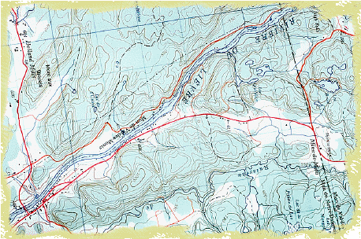
Perceptual Mapping
  A map that reveals the key dimensions along which potential customers perceive products and evaluate them

Slide 25
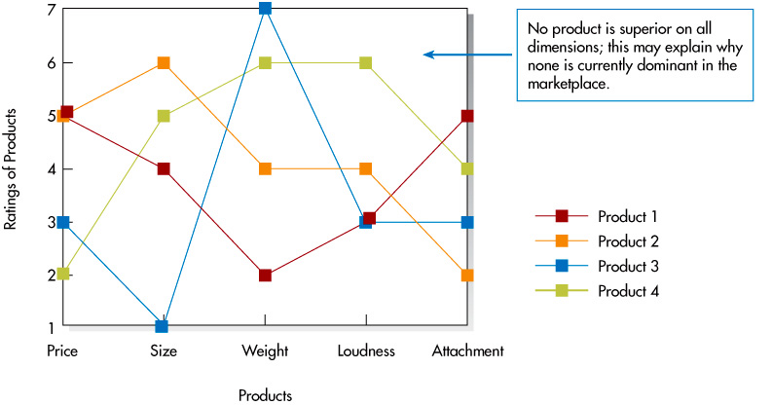
Perceptual Maps for Object Locators

Slide 26
Focus Groups
Groups of 8 to 12 people similar to potential customers
Meet for one to two hours to describe their perceptions of and reactions to relevant products
Identify the key dimensions along which focus group members perceive and evaluate various products

Slide 27
Indirect Techniques
Examine secondary data including
Sales of competing products
Demographic data
Trends (economic, lifestyle, etc.)

Slide 28
Government Policies and Regulations
May make it harder or easier to start and run a new venture
Gather relevant information on the government policies and regulations that will affect a new business

Slide 29
Taxes
Reduction of Marginal Tax Rates
Growth of New Ventures

Slide 30
Tax Incentives
Depreciation
Location in certain geographic regions
Renovation and improvement of older buildings
Tax credits

Slide 31
Government Policy
Small Business Regulatory Enforcement Fairness Act
Unfunded Mandates Reform Act
Small Business Innovation Research (SBIR) program
8(a) Business Development Program
Small Disadvantaged Businesses
HubZone Empowerment Contracting Program

Slide 32
Health and Safety
Occupational Safety and Health Act of 1970 (OSHA) requires employers to
Provide safe and healthy work environment
Comply with specific standards
Keep records of occupational injuries and illnesses

Slide 33
Discrimination
Title VII of the Civil Rights Act of 1964 prohibits employers from basing employment decisions on race, color, religion, sex, or national origin
Americans with Disabilities Act of 1990 prohibits discrimination against persons with disabilities

